Slide 1
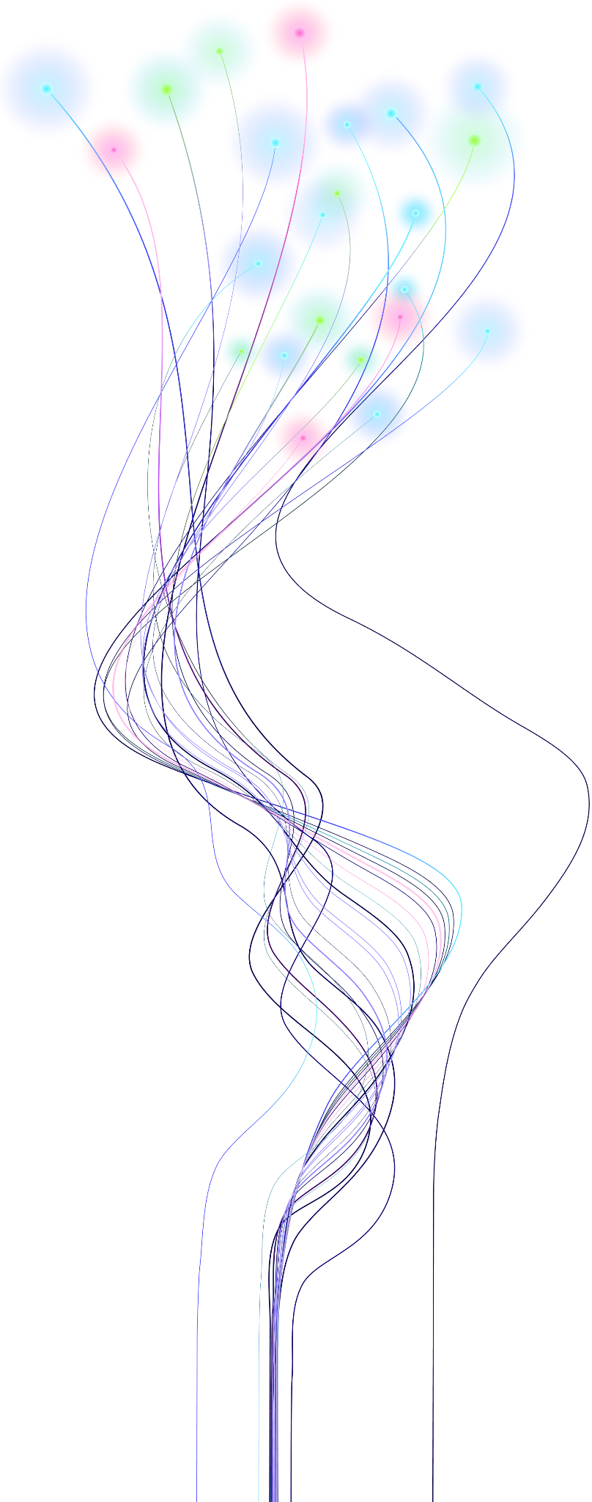

Modernizing Artifact Storage at Uber
Preetam Dwivedi
Manjari Akella
Notes:
Good afternoon everyone,
We are here today to present our talk on “Modernizing Artifact Storage at Uber” which is essentially our journey of migrating Uber’s Artifactory deployment from Onprem hosted to jFrog Saas hosted.

Slide 2


About Us
Preetam Dwivedi
Staff Engineer,
Developer Platform,
Uber
Manjari Akella
Sr. Engineer,
Developer Platform,
Uber
Notes:
I am Preetam Dwivedi, Staff Engineer at Uber working with-in Developer Platform group
And
I am Manjari, Sr. Engineer at Uber working with-in Developer Platform as well

Slide 3
Outline
Engineering at Uber
Artifactory Concepts
Onprem Architecture
Cloud Architecture
Results, Trade-offs & Learnings
Q&A

Slide 4

Engineering at Uber
local_taxi
On Our Way
Copyrights @ 2026 – JFrog all rights reserved
Notes:
Most of you probably use Uber, whether it’s for rides or food or groceries.
Can i get hands up for folks who took Uber today to come here?
And how many of you use Uber in general for rides and getting food?
There’s a tremendous amount of engineering behind that experience.
A big part of it is enabled by Uber’s Developer Platform, which provides the tools, infrastructure, and systems that help engineers build, test, and ship software at Uber scale.

Slide 5
Uber Engineering at Scale
Development Scale
Monorepo Stats
5K+
Engineers
36K+
Commits / Week
Go
35 GB
• 227M+ LOC
• 22K commits/wk
Java
17 GB
• 57M+ LOC
• 3.4K commits/wk
iOS
9 GB
• 20M LOC
• 1.2K commits/wk
3M+
Builds / Week
440M+
Lines of Code
Web
18 GB
• 81M LOC
• 4K commits/wk
Python
11 GB
• 40M LOC
• 3.2K commits/wk
Android
7 GB
• 16M LOC
• 1.8K commits/wk
Copyrights @ 2026 – JFrog all rights reserved
Notes:
We support 6 language based monorepos, Go, Java, Web, Python, Android and iOS where more than 5K users contribute, generating over 36K commits/wk, which trigger more than 3M builds/wk downloading various packages, uploading build artifacts and that’s where we deploy Artifactory at Uber

Slide 6
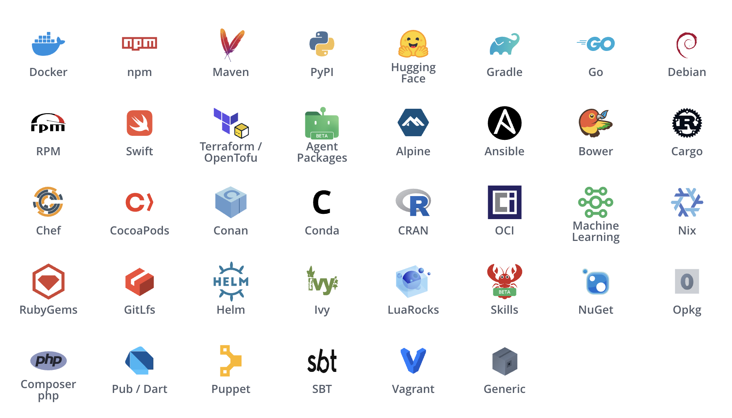
Artifactory at Uber Scale
Scale & Volume Metrics
Supported Packages and Registries
bolt
200M
Requests Per Day
cloud_upload
7TB
Uploaded / Month
cloud_download
7PB
Downloaded / Month
storage
145TB
Total Storage
Copyrights @ 2026 – JFrog all rights reserved
Notes:
Artifactory is a foundational part of Uber’s software supply chain, storing and distributing PB scale of artifacts to support Uber’s developer ecosystem.
With 200M requests/day, 7TB artifacts uploaded a month and 7PB of artifacts downloaded, encompassing a total storage of 145TB.
On the right, you can see all the supported registries in Artifactory though we don’t use all of them, the most prominent ones are docker, npm, pypi, gradle, go, maven

Slide 7
Artifactory Concepts
Copyrights @ 2026 – JFrog all rights reserved
Notes:
So before we get into weeds, lets recap some of the basic concepts about Artifactory

Slide 8


Repository Types
storage
cloud
sync
layers
Local
Remote
Federated
Virtual
dns
Sync
computer
Client
dns
Local
computer
Client
play_for_work
Proxy/Cache
cloud
External
dns
Cluster A
dns
Cluster B
computer
Client
layers
Virtual
cloud
Copyrights @ 2026 – JFrog all rights reserved
Notes:
So, Artifactory Support four types of repositories,
Local repos are stores internal first-party artifacts
Remote repos are caches to external third party registries like mavencentral, docker
Federated repos are similar to local which stores internal first party artifacts but provide bi-directional sync across 2 artifactory clusters
Virtual repos are composed views of other repositories (local, remotes, federated)

Slide 9


Artifacts are content addressable
Requested Logical Path
/artifactory/generic/sample/-/sample.tgz
Old Pointer
New Pointer
storage
v1 (Superseded)
SHA256: ABC
storage
v2 (Active Content)
SHA256: XYZ
Copyrights @ 2026 – JFrog all rights reserved
Notes:
And the second thing is Artifacts are content addressable, meaning you can generate a checksum for a content/artifact and reference it using to store/read from storage systems (disk or blob stores). Path to an artifact is just use friendly reference to the content at a point in time, if content changes reference can remain the same and it will just start pointing to a new content by using it’s checksum.

Slide 10
Onprem Architecture
Copyrights @ 2026 – JFrog all rights reserved

Slide 11
Onprem Architecture
USERS / CLIENTS
person
dns
Active-Active Cluster
High-availability deployment across active data centers.
GeoDNS
storage
Artifacts on Local Disk
Stored directly on local SSDs with node-level redundancy.
DATACENTER 1
DATACENTER 2
Optimistic Quorum
Accepts uploads and replicates asynchronously to meet quorum without blocking clients.
groups
storage Nodes
Local Disk (SSD)
storage Nodes
Local Disk (SSD)
replicate
Pull Replication
Event and cron based pull replication
dns MySQL
Metadata DB
dns MySQL
Metadata DB
sync
Notes:
Onprem deployment consisted of 2 clusters deployed across 2 data centers in Active-Active set-up where each cluster stored artifacts to local disk and had it’s own MySQL DB. On uploads, cluster attempted optimistic quorum (asynchronously to other nodes) and then between the clusters it did event & cron based pull replication.

Slide 12
Onprem Repository Structure
DC1
DC2
VIRTUAL REPOSITORY
repo
VIRTUAL REPOSITORY
repo
Events
1. LOCAL (Primary)
repo-dc1
2. REMOTE (Fallback)
repo-dc2
3. REMOTE (External)
repo-external
3. REMOTE (External)
repo-external
2. REMOTE (Fallback)
repo-dc1
1. LOCAL (Primary)
repo-dc2
public
EXTERNAL REGISTRY

Slide 13
Challenges of the Onprem Architecture
storage
warning
sync
upgrade
alt_route
Disk Space Constraints
Hardware Failures
Risk of Data Loss
Upgrades / Patches
Divergent State
Copyrights @ 2026 – JFrog all rights reserved
Notes:
So lets go over some of the challenges of the onprem Architecture,

Slide 14

Example: Target Uploaded to DC1
DC1 (Upload Target)
DC2 (Fetch)
VIRTUAL REPOSITORY
repo
VIRTUAL REPOSITORY
repo
Event
1. LOCAL (Upload Target)
repo-dc1
✓ File Stored Locally
Checksum: A
2. REMOTE (Fallback)
repo-dc2
2. REMOTE (Fallback)
repo-dc1
⚡ Query DC1 for Missing File
Checksum: A
1. LOCAL (Miss)
repo-dc2
✗ Not Found Locally
User Read from DC1
CONSISTENT READ STATE: Both reads from DC1 and DC2 receive Checksum A
User Read from DC2
Copyrights @ 2026 – JFrog all rights reserved

Slide 15
Example: Target Upload with Different Content from DC2
DC1 (Target Already Exists)
DC2 (New Upload; Same Target)
VIRTUAL REPOSITORY
repo
VIRTUAL REPOSITORY
repo
Event
1. LOCAL (Upload A)
repo-dc1
Checksum: A
2. REMOTE (Fallback)
repo-dc1
⚡ Query DC2 for Missing File
Checksum: B
2. REMOTE (Fallback)
repo-dc1
Checksum: A
1. LOCAL (Upload B)
repo-dc2
Checksum: B
User Read from DC1
CONFLICTING READ STATE: Client receives divergent checksums (A vs B)
User Read from DC2
Copyrights @ 2026 – JFrog all rights reserved

Slide 16
Cloud Architecture
Copyrights @ 2026 – JFrog all rights reserved

Slide 17


JFrog Cloud (SaaS) Architecture
Active-Active Cluster
Uber Infra
JFrog SaaS
dns
Proxy (DC1)
DC1 (Cloud Artifactory)
Federated Repository
DC1 DNS
Nodes
dns
Database
Nodes
sync
cloud_queue
Blob Store
Access Federation
group
GeoDNS
fallback
Cloud Blob Storage
replicate
cloud
DC2 (Cloud Artifactory)
Nodes
dns
Database
Fallback Routing
Proxy (DC2)
alt_route
DC2 DNS
Nodes
Blob Store
person
cloud_queue
Client
Notes:
The challenges mentioned

Slide 18
Cloud Repository Structure
DC1
DC1
DC2
DC2
VIRTUAL REPOSITORY
repo
VIRTUAL REPOSITORY
repo
VIRTUAL REPOSITORY
repo
VIRTUAL REPOSITORY
repo
1. FEDERATED
repo-federated
2. REMOTE
repo-external
2. REMOTE
repo-external
1. FEDERATED
repo-federated
1. FEDERATED (Replicated)
repo-federated
1. FEDERATED (Replicated)
repo-federated
public
EXTERNAL REGISTRY
Replication
Copyrights @ 2026 – JFrog all rights reserved

Slide 19
Example: Target Uploaded to DC1
DC1 (Upload Target)
DC2 (Replicated Target)
VIRTUAL REPOSITORY
repo
VIRTUAL REPOSITORY
repo
Replicate
1. LOCAL FEDERATED TARGET
repo-federated
Checksum: A
1. LOCAL FEDERATED TARGET
repo-federated
⚡ Checksum: A
User Read from DC1
CONSISTENT READ STATE: Both reads from DC1 and DC2 receive Checksum A
User Read from DC2
Copyrights @ 2026 – JFrog all rights reserved

Slide 20
Example: Target Upload with Different Content from DC2
DC1 (Replicated Target)
DC2 (Upload Target)
VIRTUAL REPOSITORY
repo
VIRTUAL REPOSITORY
repo
Replicate
1. LOCAL FEDERATED TARGET
repo-federated
⚡ Checksum: B
✓ Overwritten by Latest Version
1. LOCAL FEDERATED TARGET
repo-federated
Checksum: B
User Read from DC1
CONSISTENT READ STATE: Both reads from DC1 and DC2 receive Checksum B
User Read from DC2
Copyrights @ 2026 – JFrog all rights reserved

Slide 21
Uber’s Proxy
Copyrights @ 2026 – JFrog all rights reserved
Notes:
Thanks Preetam. So we just looked at the Cloud architecture and the biggest component we have as part of this is the proxy. Let’s look at it it’s features next.

Slide 22
Core Proxy Features
security
visibility
Authentication & Identity
Manages short-lived session tokens and in-memory storage.
Tracing & Observability
Provides deep request visibility, logging, and metrics.
swap_horiz
alt_route
On-Prem to Cloud
Enables seamless and secure transitioning from on-prem environments.
Failover Routing
Enables dynamic, resilient traffic redirection during outages.
Copyrights @ 2026 – JFrog all rights reserved
Notes:
Authentication and identity

Slide 23
User Authentication and Identity Forwarding
Proxy (Uber Infra)
person
Uber SSO
SSO Authenticator
Validates Auth on On-Prem & Cloud
Onprem Artifactory
Uber Infra
Route On-Prem
(Mode: onprem)
User
Uber Developer/
Automations
Token Exchange
Uber SSO → Artifactory/JFrog Tokens
Dynamic Router
Evaluates Repository Status & health to direct traffic
Cloud Artifactory
JFrog SaaS
Route Cloud
(Mode: cloud)
Copyrights @ 2026 – JFrog all rights reserved
Notes:
Slide

Slide 24
Core Proxy Features
security
visibility
Authentication & Identity
Manages short-lived session tokens and in-memory storage.
Tracing & Observability
Provides deep request visibility, logging, and metrics.
swap_horiz
alt_route
On-Prem to Cloud
Enables seamless and secure transitioning from on-prem environments.
Failover Routing
Enables dynamic, resilient traffic redirection during outages.
Copyrights @ 2026 – JFrog all rights reserved
Notes:
Next - let’s look at how we used the proxy to migrate from onprem to cloud.

Slide 25
Data Migration
On-Prem Artifactory
Uber Infrastructure
Cloud Artifactory
JFrog SaaS
Phase 1: Initial Bulk Transfer
Using JFrog CLI + Custom Scripts
Local Repositories
Federated Repos
Push Replication
Phase 2: Continuous Sync
Event & Cron based Push Replication
Copyrights @ 2026 – JFrog all rights reserved
Notes:
Next - let’s talk about the phases of rollout. First - we need to migrate the data over…Slide…

Slide 26
Onprem behind Proxy Rollout
Proxy (Uber Infra)
DNS Routing Layer
Authentication
Onprem Artifactory
Uber Infra
person
Zone-by-Zone
Rollout
After
User
Devs & Automation
Direct On-Prem Router
Token Exchange
Before: Direct Path
Copyrights @ 2026 – JFrog all rights reserved
Notes:
Next comes the rollout of the proxy itself. We introduce proxy as an additional layer between the DNS routing and the onprem artifactory.

Slide 27
Dual Write Rollout
UI upload
Proxy (Uber Infra)
Onprem Artifactory
Primary
Uber Infra
Authentication
person
Dynamic Router
Push replication
Programmatic
Upload
Upload
User
Devs & Automation
Cloud Artifactory
Secondary
JFrog SaaS
Token Exchange
Note: If one of them failed, we would fail the upload as a whole.
Copyrights @ 2026 – JFrog all rights reserved
Notes:
Once we rolled out on prem behind the proxy - the next step was to ensure that cloud was tracking as closely as possible and with little lag to the state of onprem in order to “flip the switch”.
To help with this, we implemented a feature called dual write. It’s what it sounds like - uploads that come through are written to both onprem and cloud artifactory. Slide note.

Slide 28
Cloud Shadow Rollout
Proxy (Uber Infra)
Onprem Artifactory
Primary
Uber Infra
Authentication
person
Dynamic Router
Download
SHADOW
User
Devs & Automation
Cloud Artifactory
Secondary
JFrog SaaS
Token Exchange
Record & Replay
Compare
X-Uber-Art-Shadow-Cloud: true
Recorded
Data
Copyrights @ 2026 – JFrog all rights reserved
Notes:
Next we set up the routing from the Proxy layer to cloud Artifactory. However, before we perform the full migration - we rolled out a shadow testing workflow that recorded all live traffic and replayed a percentage of it. Slide. This was done to ensure parity of data being served from onprem and cloud is exactly the same and end users do not see any discrepancies. Slide.

Slide 29
Correctness Verification for Shadow testing
rule
fingerprint
straighten
text_snippet
Status Code
Validates HTTP response status codes match exactly between environments.
Checksum
Verifies and matches cryptographic checksums of transferred artifacts.
Artifact Size
Compares declared HTTP Content-Length headers and ensures raw response byte sizes are precisely identical.
Response Bytes
Deep byte-by-byte comparison executed for text-based artifact use cases.
Copyrights @ 2026 – JFrog all rights reserved
Notes:
While performing shadow testing we validated several key characteristics of the responses.
First line of defense is the status code comparator that validates existence of artifacts in both clusters.
In addition to this, we also validated checksum of artifacts, content length headers, computed response body length and byte by byte comparison of text based artifacts returned the exact same values.

Slide 30
Cloud Rollout
Proxy (Uber Infra)
Onprem Artifactory
Secondary
Uber Infra
Authentication
person
Dynamic Router
User
Devs & Automation
Cloud Artifactory
Primary
JFrog SaaS
Token Exchange
Rollout Strategy: Gradual rollout executed on a per-repository basis, prioritizing low-traffic repositories first, and then systematically migrating all remaining repositories.
Copyrights @ 2026 – JFrog all rights reserved
Notes:
Finally once we verified the correctness via shadow testing - we performed the switch from on prem to cloud on a per repo basis. We analyzed traffic across repositories and phased the rollout based on traffic patterns - releasing low traffic repos first.

Slide 31
End State
Proxy (Uber Infra)
Cloud Artifactory
Primary
JFrog SaaS
person
Authentication
User
Devs & Automation
Token Exchange
Copyrights @ 2026 – JFrog all rights reserved
Notes:
This slide shows the workflow after the final migration and the state of artifactory at uber today.

Slide 32
Core Proxy Features
security
visibility
Authentication & Identity
Manages short-lived session tokens and in-memory storage.
Tracing & Observability
Provides deep request visibility, logging, and metrics.
swap_horiz
alt_route
On-Prem to Cloud
Enables seamless and secure transitioning from on-prem environments.
Failover Routing
Enables dynamic, resilient traffic redirection during outages.
Copyrights @ 2026 – JFrog all rights reserved
Notes:
Next let’s look at how we leverage the proxy for observability

Slide 33
Observability
error
speed
track_changes
Error Classification
Categorizes system errors in real-time across internal services and external APIs.
Request Latency
Provides granular, hop-by-hop latency breakdowns at the 95th and 99th percentiles.
Lag Detection
Monitors replication delay across environments and automatically triggers on-call pages.
Notes:
Since the proxy intercepts every request and bridges any service calls downstream we are able to tap into the request at various stages of its lifecycle. Hence - slide.

Slide 34
Federated Repository Lag Detection: JFrog API
Proxy (Uber Infra)
Periodically triggers API calls to monitor replication state
API Poll (Fetch State)
Detects Lag & Health
Cloud Artifactory
JFrog SaaS
Federated Repository State
Detected Metrics
• Replication Lag (millis)
• Replication Health Status
Lag / Unhealthy State
On-Call Paged
support_agent
Notes:
We have 2 ways this is monitored. For the first way - we use JFrog APIs to poll for the status of federated repositories and any lag time in replication. Alerts are then set up to trigger when either the lag time breaches a certain threshold or the status of a federated repository is not healthy.

Slide 35
Federated Repository Lag Detection: Read after write
upload
Cloud Artifactory
JFrog SaaS (DC1)
Primary Write Target
Proxy (Uber Infra)
Captures uploaded artifact path and waits for fixed delay
replicate
Cloud Artifactory
JFrog SaaS (DC2)
Secondary Read Target
download
Download Status
• Status 200: OK / No Alert
• Status 404: Lag Detected
On-Call Paged
Status is 404 (Failure)
support_agent
Notes:
Another way we set up observability for federation lag is by using the proxy to perform a “read after write”. We attempt a download on every upload that comes to the proxy; i.e - we attempt to read after every write. Slide.

Slide 36
Core Proxy Features
security
visibility
Authentication & Identity
Manages short-lived session tokens and in-memory storage.
Tracing & Observability
Provides deep request visibility, logging, and metrics.
swap_horiz
alt_route
On-Prem to Cloud
Enables seamless and secure transitioning from on-prem environments.
Failover Routing
Enables dynamic, resilient traffic redirection during outages.
Copyrights @ 2026 – JFrog all rights reserved
Notes:
Finally let’s look at how we are able to provide high availability and uptime of artifactory using different routing switches in the proxy.

Slide 37
Disaster Recovery: Happy Path
lan
cloud_done
Uber DC 1 / Proxy
[STATUS: ACTIVE]
Cloud Artifactory
JFrog SaaS - DC1
(Active)
alt_route
DNS
STATUS: ACTIVE
Active DC Failover Policy
lan
cloud_done
Uber DC 2 / Proxy
[STATUS: ACTIVE]
Cloud Artifactory
JFrog SaaS - DC2
(Active)
Copyrights @ 2026 – JFrog all rights reserved
Notes:
Before we look at some outage scenarios - let’s recap what the happy path routing looks like.

Slide 38


Disaster Recovery: Uber Data Center Failover
lan
cloud_done
block
Uber DC 1 / Proxy
[STATUS: UNAVAILABLE]
Cloud Artifactory
JFrog SaaS - DC1
(Active)
alt_route
DNS
STATUS: FAILOVER
Active DC Failover Policy
lan
cloud_done
Uber DC 2 / Proxy
[STATUS: ACTIVE]
Cloud Artifactory
JFrog SaaS - DC2
(Active)
Copyrights @ 2026 – JFrog all rights reserved
Notes:
In this event of an Uber DC failover - we navigate all requests through the other data center. In this slide for e.g Slide….

Slide 39
Disaster Recovery: JFrog Cloud DC Failover
lan
cloud_done
Uber DC 1 / Proxy
[STATUS: ACTIVE]
Cloud Artifactory
JFrog SaaS - DC1
(Active)
alt_route
DNS
STATUS: ACTIVE
Active DC Failover Policy
fallback
lan
cloud_done
Uber DC 2 / Proxy
[STATUS: FAILOVER]
(Automated Cloud Failover)
Cloud Artifactory
JFrog SaaS - DC2
(Unavailable)
Copyrights @ 2026 – JFrog all rights reserved
Notes:
In the event of a Jfrog data center failure; we have an internal fallback mechanism where the all traffic from internal uber DCs is routed to the active and available SaaS instance. Note that this fallback is always active and requires no manual intervention should a SaaS cluster go down.

Slide 40
Disaster Recovery: Uber and JFrog Cloud DC Failover
lan
cloud_done
block
Uber DC 1 / Proxy
[STATUS: UNAVAILABLE]
Cloud Artifactory
JFrog SaaS - DC1
(Active)
alt_route
DNS
STATUS: FAILOVER
Active DC Failover Policy
fallback
lan
cloud_done
Uber DC 2 / Proxy
[STATUS: FAILOVER]
(Automated Cloud Failover)
Cloud Artifactory
JFrog SaaS - DC2
(Unavailable)
Copyrights @ 2026 – JFrog all rights reserved
Notes:
Finally - if we run into a more severe failure that affects both uber and jfrog SaaS cloud DC - we have internal switches to route traffic through any available path. We use a combination of the techniques from previous scenarios. Slide.
Next I’ll hand it back to Preetam to talk about the impact of this migration at Uber and some learnings we took with us along the way.

Slide 41
Results, Trade-offs and Learnings
Copyrights @ 2026 – JFrog all rights reserved
Notes:
Transition from Uber Engineering at Scale -> Artifactory at Scale can be made smoother so it doesn’t feel abrupt

Slide 42
Results & Impact
check_circle
bolt
insights
thumb_up
Availability
ON-PREM:
Not Measured
CLOUD:
99.99%
Latency
ON-PREM:
Low Latency
CLOUD:
Comparable
Visibility
ON-PREM:
Minimal
CLOUD:
Full Coverage
Dev Exp
ON-PREM:
High Friction
CLOUD:
Improved
Notes:
Add Developer Experience

Slide 43
Trade Offs
construction
engineering
cloud_done
Uber Infrastructure
Natural Integration
Leverages existing monorepo & deployment infrastructure seamlessly.
Zero-Touch Upgrades
Platform upgrades happen naturally with no manual steps required for the team.
Integration & Overhead
Auth Complexity
Requires additional integration work and special Auth handling for Docker and Terraform.
Operational Learning
Team must learn proxy capabilities including authentication, and registry mechanics.
JFrog SaaS Benefits
check_circle Access Federation
check_circle Curation
check_circle Federated Repos
check_circle Upgrades & Patches

Slide 44
Key Learnings
alt_route
autorenew
security
Shadow Validation
Universal Concept
Implementing shadowing has proven invaluable for validating production traffic structures safely.
Future Paradigm
Carry Forward
Established as a core engineering paradigm carried forward to multiple newer software projects today.
Registry & Auth
Secure External Ingress
Overcoming orchestration bottlenecks and handling token translation for complex external Docker pulls required implementing a robust multi-request authentication setup.
Copyrights @ 2026 – JFrog all rights reserved

Slide 45
Thank You

Slide 46

Q&A
Copyrights @ 2026 – JFrog all rights reserved

